Slide 1
GENERATIVE MODELING
HIMANSHU ARORA

Slide 2
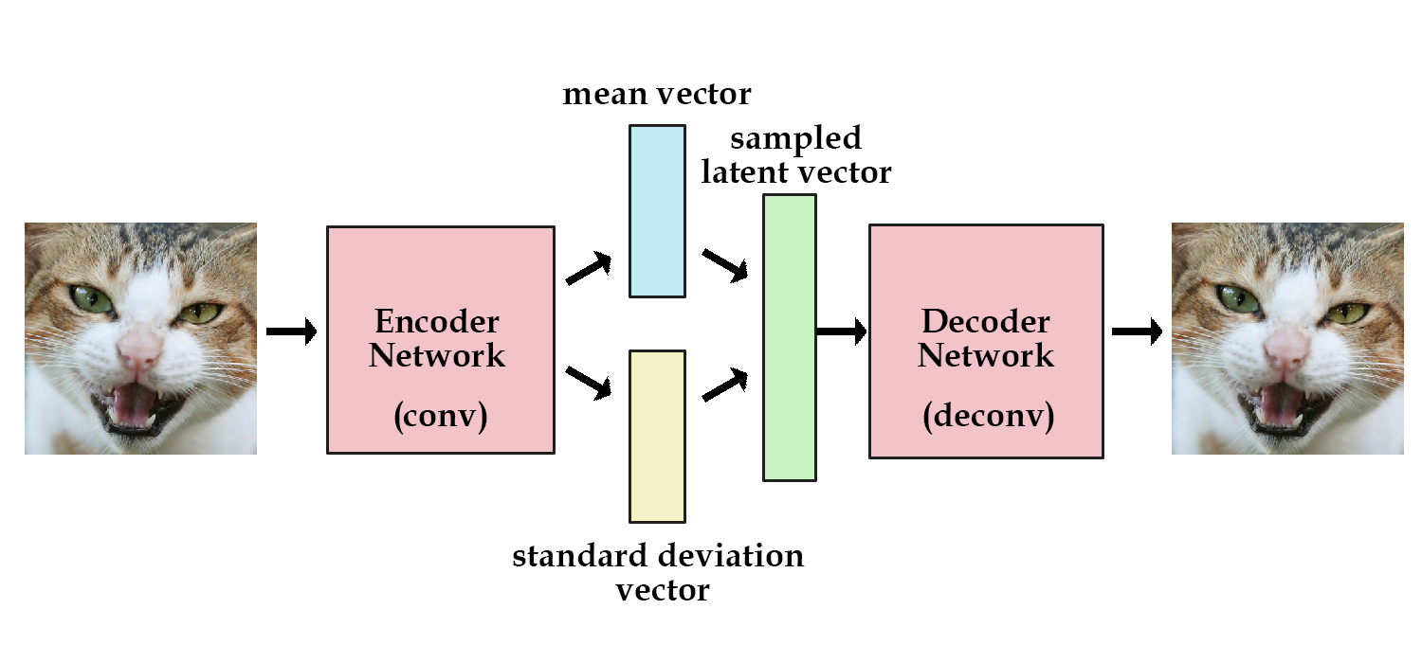

THE TWO MOST COMMON ARCHITECTURES
Variational Autoencoder
Generative Adversarial Network
Image sources:
https://skymind.ai/wiki/generative-adversarial-network-gan

Slide 3
APPLICATIONS

Slide 4
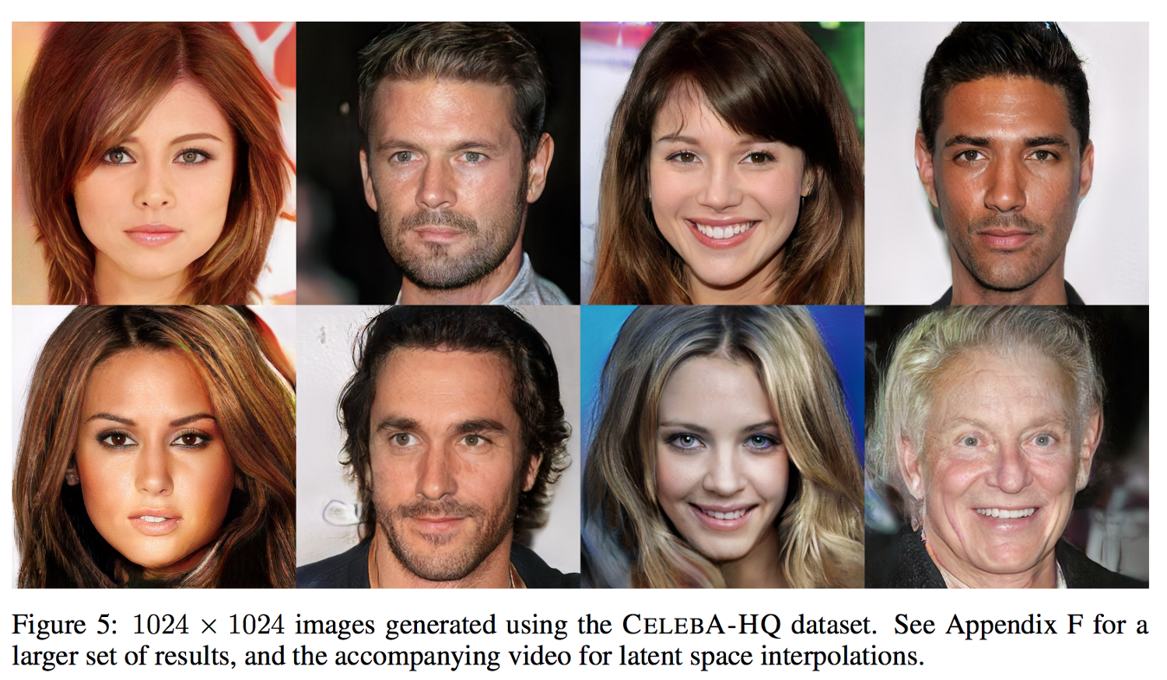
GENERATING FACES (PROGRESSIVE GANS)
Image source: https://arxiv.org/pdf/1710.10196.pdf

Slide 5
IMAGE SYNTHESIS (PIX2PIX)
Image source: https://tcwang0509.github.io/pix2pixHD/

Slide 6
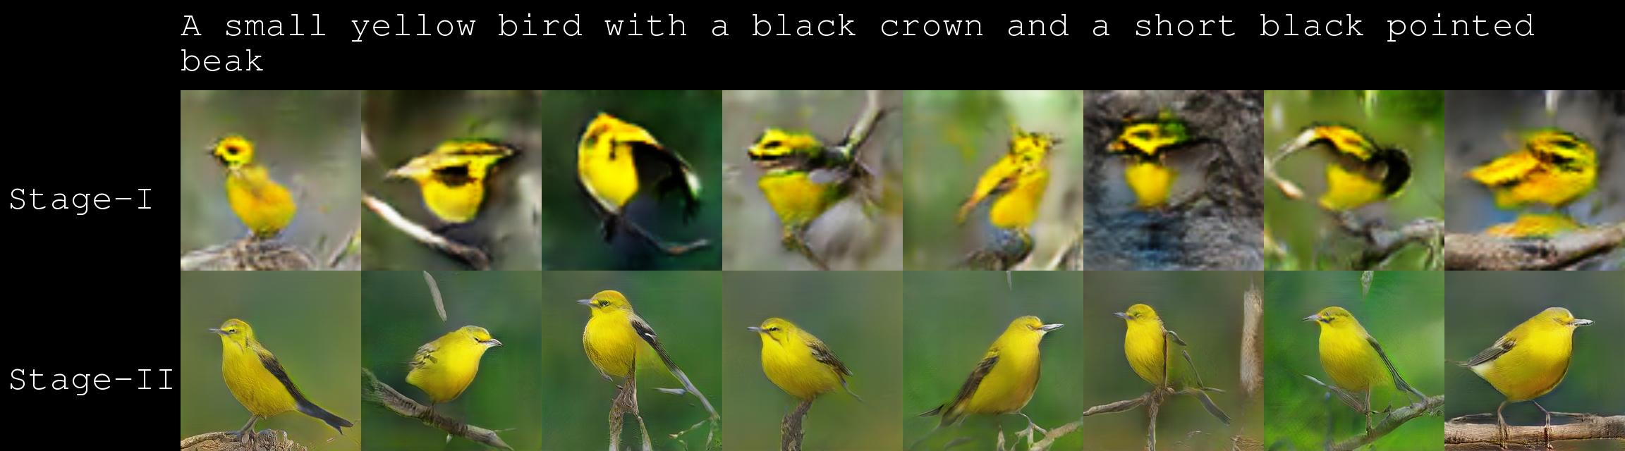
TEXT TO IMAGE (STACK-GAN)
Image source https://github.com/hanzhanggit/StackGAN

Slide 7

VIDEO GENERATION

Slide 8
VECTOR ARITHMETIC

Slide 9
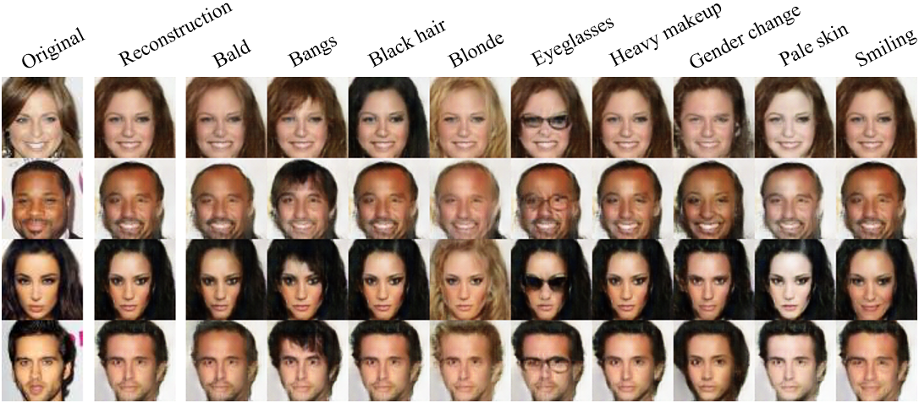
IMAGE EDITING (IC-GAN)
Image source: https://github.com/Guim3/IcGAN

Slide 10
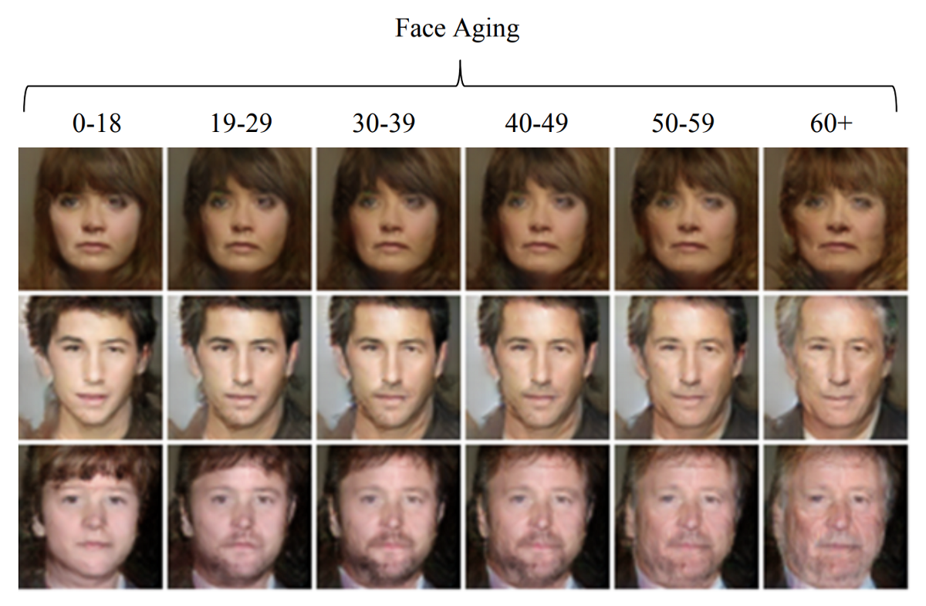
IMAGE EDITING (AGE-CGAN)
Image source: https://arxiv.org/pdf/1702.01983.pdf

Slide 11
IMAGE EDITING (NEURAL PHOTO EDITOR)
Image source https://github.com/ajbrock/Neural-Photo-Editor

Slide 12
LATENT SPACE INTERPOLATION

Slide 13
IMAGE
Image sources
https://github.com/ptrblck/prog_gans_pytorch_inference
https://twitter.com/phillip_isola/status/1066832052203503616

Slide 14
IMAGE
Image sources
https://github.com/ptrblck/prog_gans_pytorch_inference
https://twitter.com/phillip_isola/status/1066832052203503616

Slide 15
MUSIC
Source: MusicVAE

Slide 16
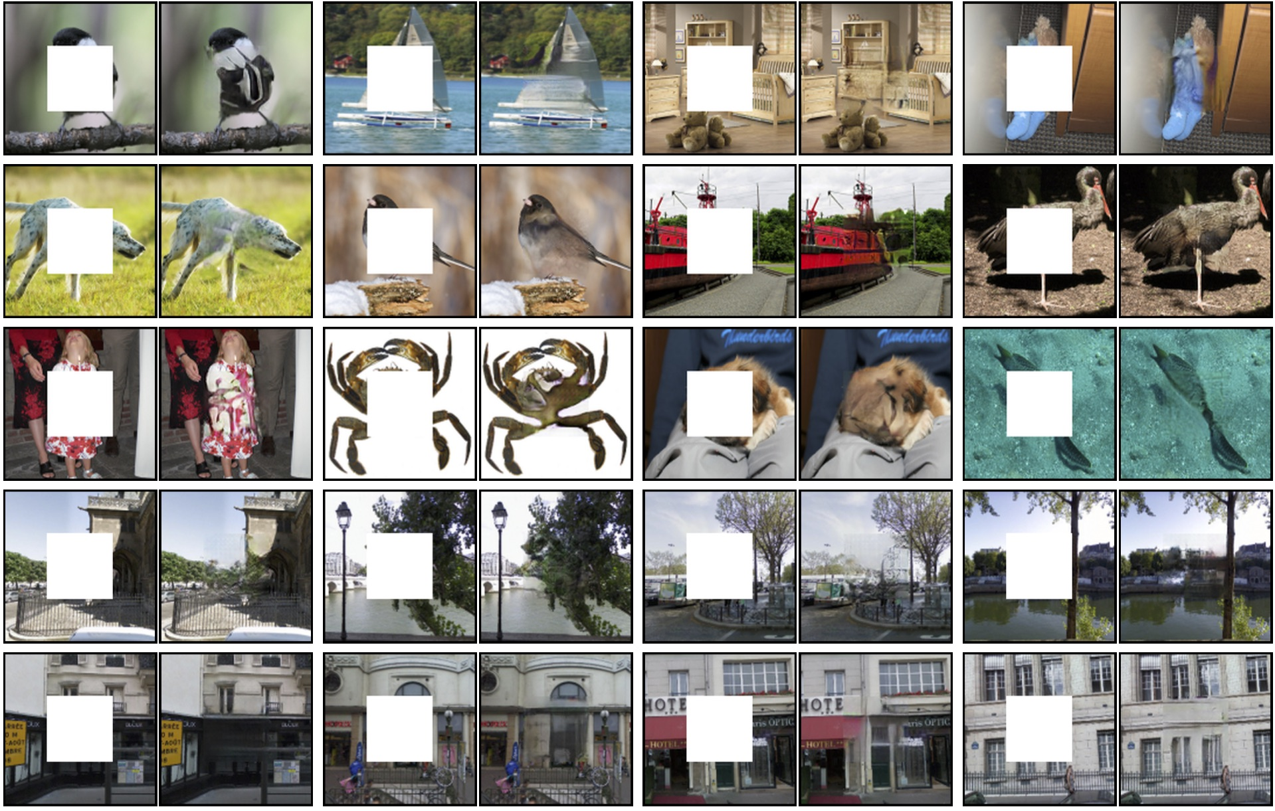
IMAGE IMPAINTING
Image source: https://github.com/pathak22/context-encoder

Slide 17
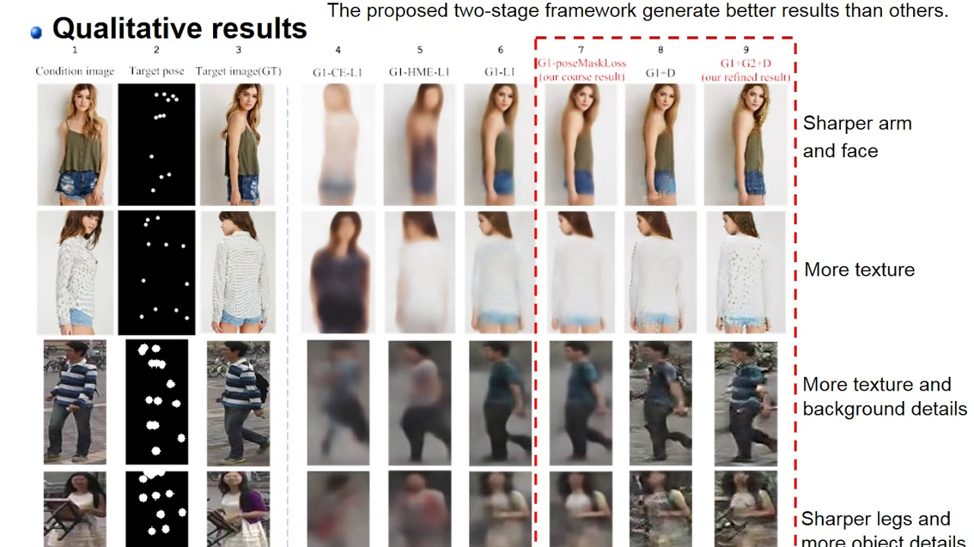
POSE GUIDED IMAGE GENERATION
Image source: https://www.youtube.com/watch?v=FBW6drMpK3U

Slide 18
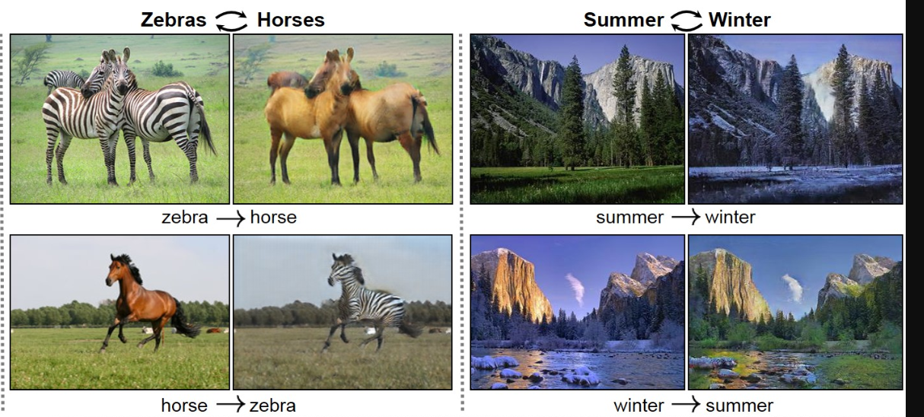
STYLE TRANSFER (CYCLEGAN)
Image source: https://github.com/junyanz/CycleGAN

Slide 19
STYLE TRANSFER (CYCLEGAN)
Image source: https://github.com/junyanz/CycleGAN

Slide 20
VARIATIONAL AUTOENCODER

Slide 21

AUTOENCODER
A type of neural network used to learn efficient data coding
Learns to compress data from the input layer into a short code, and then decompress that code into something that closely matches the original data
This forces the autoencoder to engage in dimensionality reduction, for example by learning how to ignore noise.
Content source: Wikipedia
Notes:
Used primarily for compression
The input and output are same
Bottleneck forces the model to learn the most important n features

Slide 22
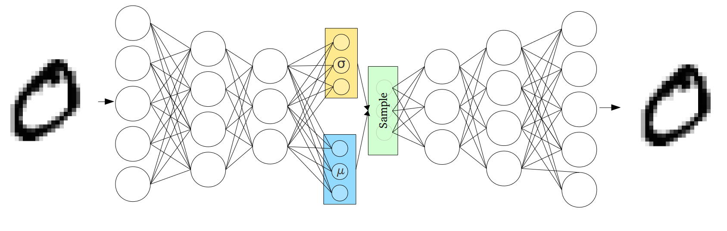
VARIATIONAL AUTOENCODER
Learns a probability distribution instead of learning a fixed value over each feature
This adds stochasticity and makes the latent space continuously meaningful
Image source: https://towardsdatascience.com/intuitively-understanding-variational-autoencoders-1bfe67eb5daf
Notes:
Even if you input the same image again, it’s latent space representation would be different

Slide 23
GENERATIVE ADVERSARIAL NETWORK

Slide 24
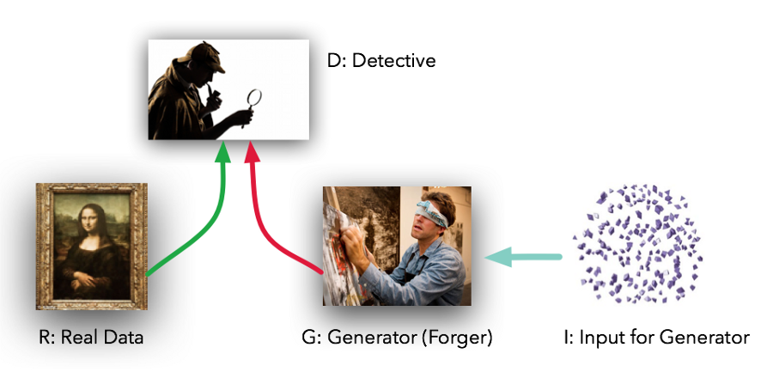
ANALOGY
Image source: https://towardsdatascience.com/generative-adversarial-networks-using-tensorflow-c8f4518406df

Slide 25
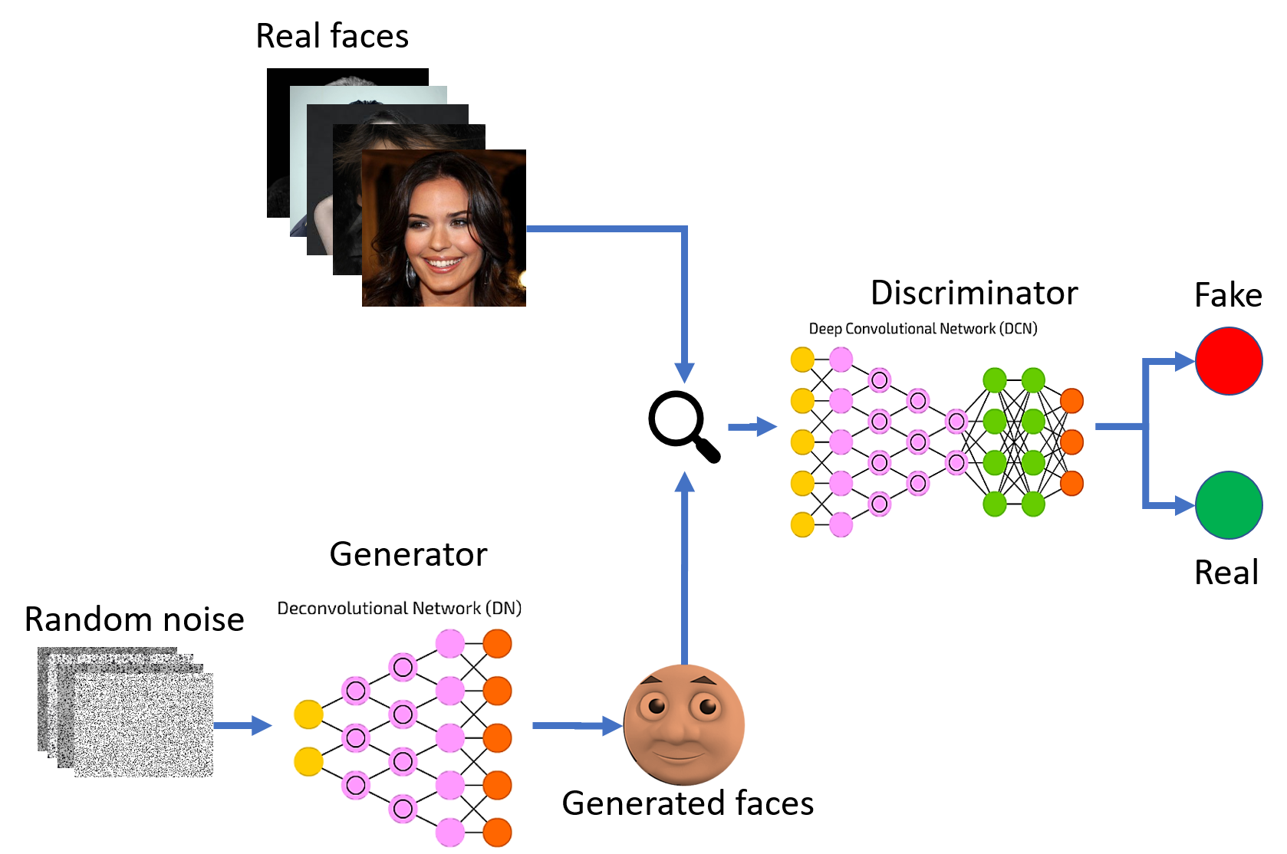
ARCHITECTURE
Image source: https://www.spindox.it/en/blog/generative-adversarial-neural-networks/

Slide 26
TRAINING A GAN
Generate a batch of random latent vectors by sampling from a normal distribution
Generate the corresponding images of those vectors using the generator model
Fetch a batch of real images from the training data
Combine the two sets of images into a single batch and create the corresponding vector of labels. Add some noise to this vector to improve robustness
Train the discriminator model using this batch of images and labels
Again generate a batch of random latent vectors by sampling from a normal distribution
Create a corresponding vector of labels with all labels being real
Feed the latent vectors and the real labels to the GAN model. Since the discriminator's weights are fixed, this causes the generator to update its weights such that the discriminator predicts those images as real. (Fool the Discriminator)

